Slide 1
ASP.NET Core Fundamentals
Scott Sauber
@scottsauber

Slide 2
Audience
Existing ASP.NET developers
People interested in the new ASP.NET Core stack

Slide 3
Who am I?
Software Developer, working primarily with web and ASP.NET
Worked with the .NET since 2009
Avid learner
Following ASP.NET Core since the early days

Slide 4
Scope
This is an Intro talk
What is ASP.NET Core?
What is .NET Core?
What stayed the same?
What changed?
New Features
Demos all throughout
Questions

Slide 5
History Lesson
1996 – Classic ASP
2002 – ASP.NET
2008 – ASP.NET MVC
2010 – ASP.NET Web Pages
2012 – ASP.NET Web API and SignalR
May 2014 – ASP.NET vNext announced
February 2015 – ASP.NET vNext named to ASP.NET 5
January 2016 – ASP.NET 5 renamed to ASP.NET Core 1.0
June 27, 2016 – ASP.NET Core 1.0 RTM Released
September 13, 2016 – ASP.NET Core 1.0.1 Released
October 25, 2016 – ASP.NET Core 1.1 Preview Released

Slide 6
What is ASP.NET Core?
Ground up rewrite
Modular, pay for play via NuGet packages
Improved performance
Downside – having to wire up everything you need
Templates
Reverse Package Search: https://packagesearch.azurewebsites.net/
Open source
Cross platform (Windows, Mac, various flavors of Linux, containers)
It’s just a console app
Runs on .NET Framework and .NET Core

Slide 7
What is .NET Core
Cross platform .NET
Trimmed down version of .NET Framework to get it to run cross-platform

Slide 8
.NET Core (continued)
Trimmed down API
Some things missing (some temporary, some permanent)
Missing permanently:
Registry (Windows thing)
Missing for now
System.Drawing
Use Image Processor
System.DirectoryServices
Coming in .NET Core 1.1 (Q4 2016, Q1 2017)
Upload your packages.config and see if you can run .NET Core
https://icanhasdot.net/
ASP.NET Core runs on top of .NET Core (and .NET Framework)
API is evolving
Big release coming in Q4 2016 or Q1 2017 to restore a lot of API’s to .NET Core

Slide 9
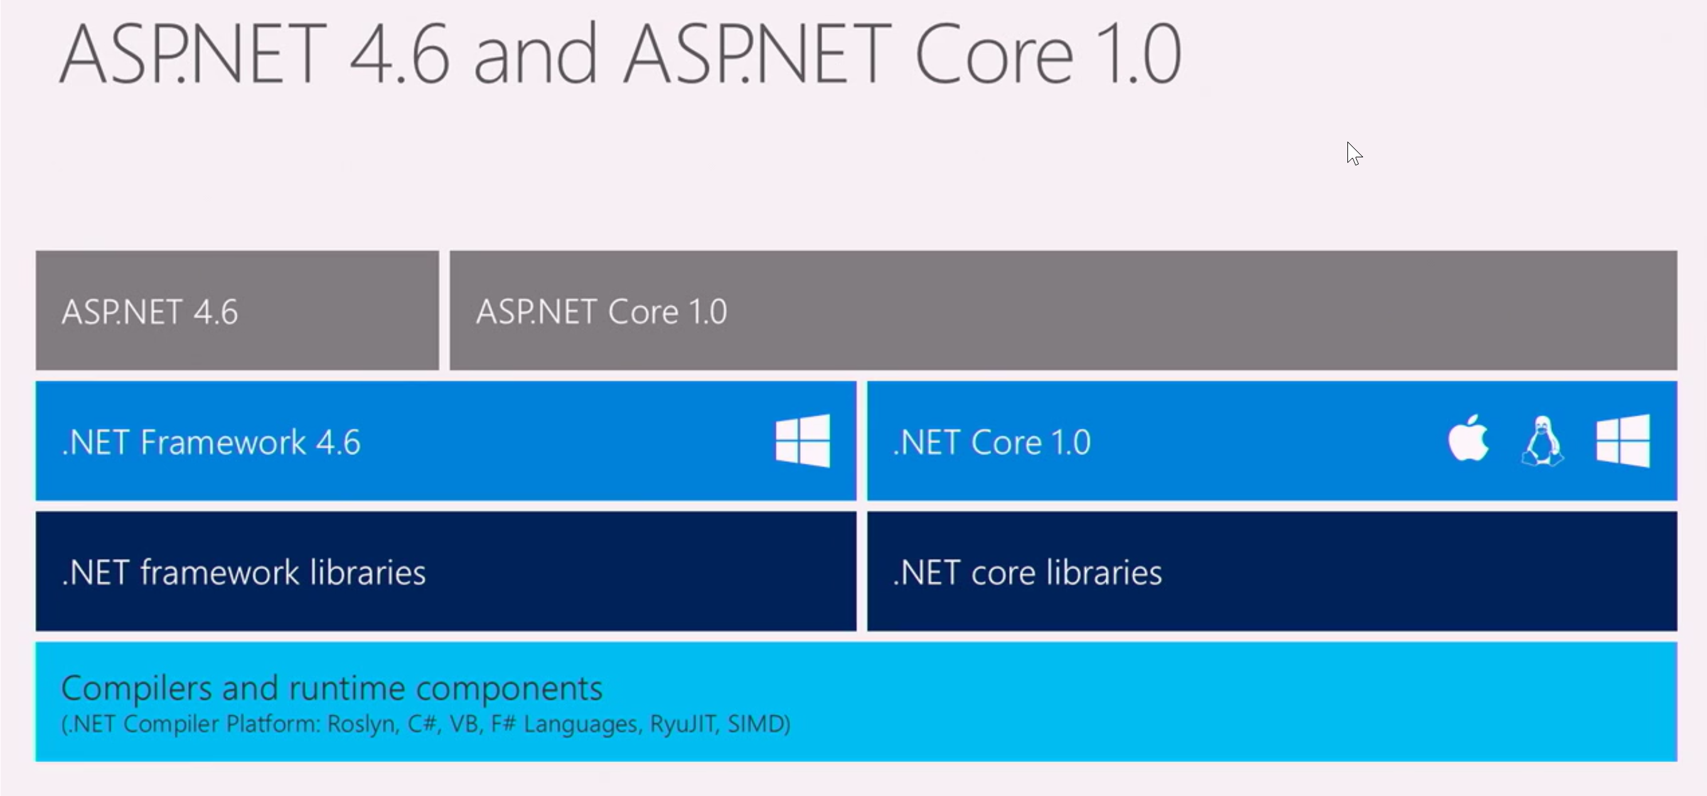
Source: Microsoft

Slide 10
.NET Core is RTM, the Tooling is not
.NET Core and ASP.NET Core are RTM
The Tooling is still in “Preview 2”
.NET Core SDK installs a local cache of NuGet packages.
NuGet restore from the Internet is slow
Fix coming in NuGet 3.5 (currently in RC)
Why ship Tooling before it’s ready?
Why should frameworks wait when Tooling is good enough?

Slide 11
dotnet CLI
What is a CLI?
Restore, Build, Run, Publish all from the command line
dotnet restore
dotnet run
Installed with the .NET Core SDK (download at http://dot.net)
Cross platform with any editor
Works for any .NET Core app, not just ASP.NET Core
Demo

Slide 12
If you use Visual Studio… you don’t have to worry about the dotnet CLI … it’s used by Visual Studio behind the scenes

Slide 13
xproj and project.json
xproj is a new project system for ASP.NET Core… for now
Benefits:
In the folder, in the project, no more Include sections
Project.json
Manage your NuGet dependencies
This is changing in the name of consistency and re-use
Csproj/msbuild is back, but is going to incorporate benefits of xproj
5 min lightning talk previewing the changes
Less XML
No “reloading” the project when changes happen externally (editing csproj file via hand, git reset, etc.)
Migration to csproj will be easy, open project, click yes, and it just happens
dotnet migrate from command line
Anticipated to be complete Q4 2016 or Q1 2017
More info released last week

Slide 14
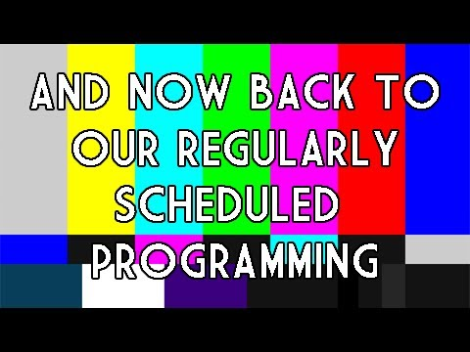

Slide 15
MVC – What’s the same?
ASP.NET MVC Concepts are the same
Still have Controllers
Controllers still have Actions
Still have Views
Still have partial views
HTML Helpers still exist
But you should use Tag Helpers

Slide 16
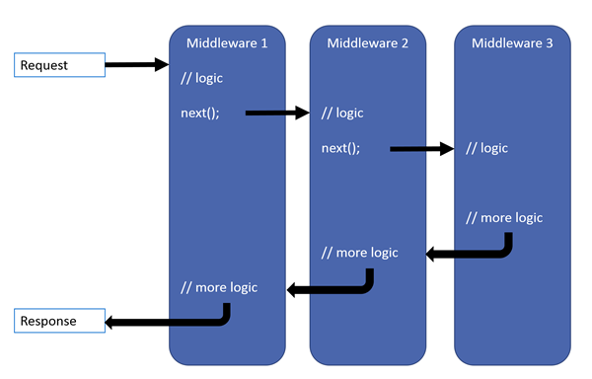
ASP.NET Core – what’s different
ASP.NET Core is simply a console app.
Web Forms is gone
WCF server is gone
Client side package management
web.config is only around for IIS compatibility
Global.asax is gone
Startup.cs
Middleware all the things, even MVC
Order matters

Slide 17
MVC – Where’s my cheese?
MVC and Web API Controllers have been unified
No more ApiController, just inherit from Controller
Child actions gone in favor of View Components
/Views/_ViewImports.cshtml is your new /Views/web.config
Instead of <add namespace=“MyNamespace.Something”/>
Just @using MyNamespace.Something
Static files now served by folder called wwwroot

Slide 18
Brand New Features
Save and reload, no more building
Dependency Injection built-in
Ship the framework with the app, side-by-side on the same server as other apps with different versions of .NET
Environments are a first class citizen
TagHelpers > Html Helpers
HtmlHelper:
TagHelper:
@Html.ActionLink("Home", "Index", "Home")
<a class="btn btn-primary" asp-controller="Home" asp-action="Index">Home</a>

Slide 19
Kestrel
Brand new web (“application”) server
Built on libuv
Cross platform

Slide 20
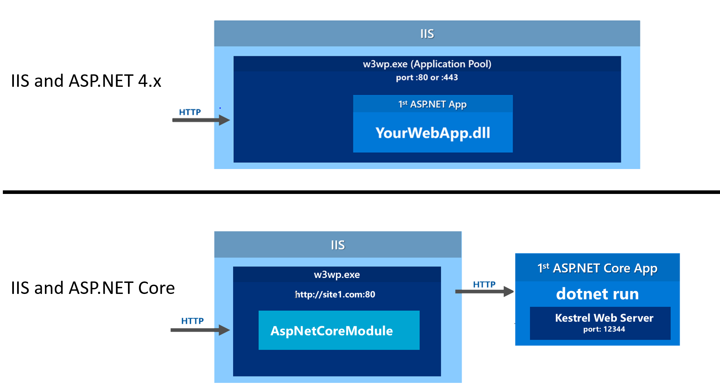
Kestrel (continued)
Do not put this directly on the Interwebs
Server in front acting as a reverse proxy
IIS on Windows
nginx or Apache on Linux
Image: Rick Strahl

Slide 21
Kestrel (continued)
Work is happening now to harden Kestrel and add features to make it Internet ready.
Source (from Community Standup)

Slide 22
Kestrel (continued again)
High performance
The stuff they do is crazy in the name of perf
More details: https://vimeo.com/172009499

Slide 23
TechEmpower Benchmarks
What are the TechEmpower Benchmarks?
https://www.techempower.com/benchmarks/
ASP.NET Core 5M requests per second
ASP.NET 4.x is 71K requests per second
PHP: 195K
Node: 289K
Go: 490K
This is a plain text – this is essentially hello world
Power of Open Source
#2 contributor to Kestrel, Ben Adams, is a non-Microsoft Employee
This is where modularity is crucial

Slide 24
What’s still coming
1.1.0 – currently in Preview 1 – RTM in Q4 2016 or Q1 2017
URL Rewriting Middleware (GG IIS URL Rewrite Module)
Response Caching Middleware
View Components as Tag Helpers
View pre-compilation
1.2 – Q1 or Q2 2017
WebSockets
SignalR
Razor Pages (Views w/out Controllers, formerly called Web Pages)
Down the road
VB support
They are tentatively planning on doing releases twice a year
https://blogs.msdn.microsoft.com/dotnet/2016/07/26/net-support-and-versioning/
Roadmap for more deets: https://github.com/aspnet/Home/wiki/Roadmap

Slide 25
How do I get started?
Go to http://dot.net
Click on the big Download .NET Core 1.0 button
Follow instructions for your OS of choice

Slide 26
So should I switch to ASP.NET Core today?
This is a 1.0.1 product with Preview Tooling.
Missing some features right now (SignalR, Output Caching, etc.)
Entity Framework Core 1.0 has some LINQ stabilization issues and missing features compared to EF6 (stored proc support, lazy loading, connection resiliency, and others).
EF Core 1.0 guidance is to stay away from async
Fix coming in 1.1
.NET Core is going to expand its API greatly
ASP.NET 4.6 is still going to be supported for a long time

Slide 27
Resources
How to get ASP.NET Core
http://www.dot.net
ASP.NET Community Standup
http://live.asp.net
ASP.NET Monsters
https://channel9.msdn.com/Series/aspnetmonsters
ASP.NET Core Documentation
https://docs.asp.net/
ASP.NET Core Source
https://github.com/aspnet
.NET Core roadmap
https://blogs.msdn.microsoft.com/dotnet/2016/07/15/net-core-roadmap/

Slide 28
Questions?
Feel free to reach out on Twitter (@scottsauber) if you remember a question later
Slides and code posted on GitHub
https://github.com/scottsauber/prairiecode16corefundamentals
Don’t forget to fill out evals, please:
http://prairiecode.amegala.com/evals

Slide 29
Evals
Don’t forget to fill out evals, please:
http://prairiecode.amegala.com/evals

Slide 30
Thanks!

